Slide 1

Fake News Detection using NLP and deep learning (Hybrid CNN-BiLSTM)
Syed Mohammad Ali Ashar F2022376084
Alisha Saleem F2022376100
Farhana Minhas F2022376126
Samra BB F2022376083

Slide 2

Presentation Outline
Introduction
Objectives
Literature Review
Methodology
Exploratory Data Analysis
Model Architecture
Results & Evaluation
Model Interpretability
Web Application
Conclusion & Future Work

Slide 3

Introduction to Fake News
Definition: Intentional misinformation presented as factual news.
Impact:
Misleads public opinion
Damages trust in authentic media
Influences political and social decisions
Relevance: Growing concern due to rapid dissemination via social media.

Slide 4

Project Objectives
Develop an effective, automated fake news detection system.
Employ advanced NLP and deep learning techniques for accurate classification.
Provide transparent, understandable model predictions for end-users.
Deploy as an interactive, accessible web application.

Slide 5
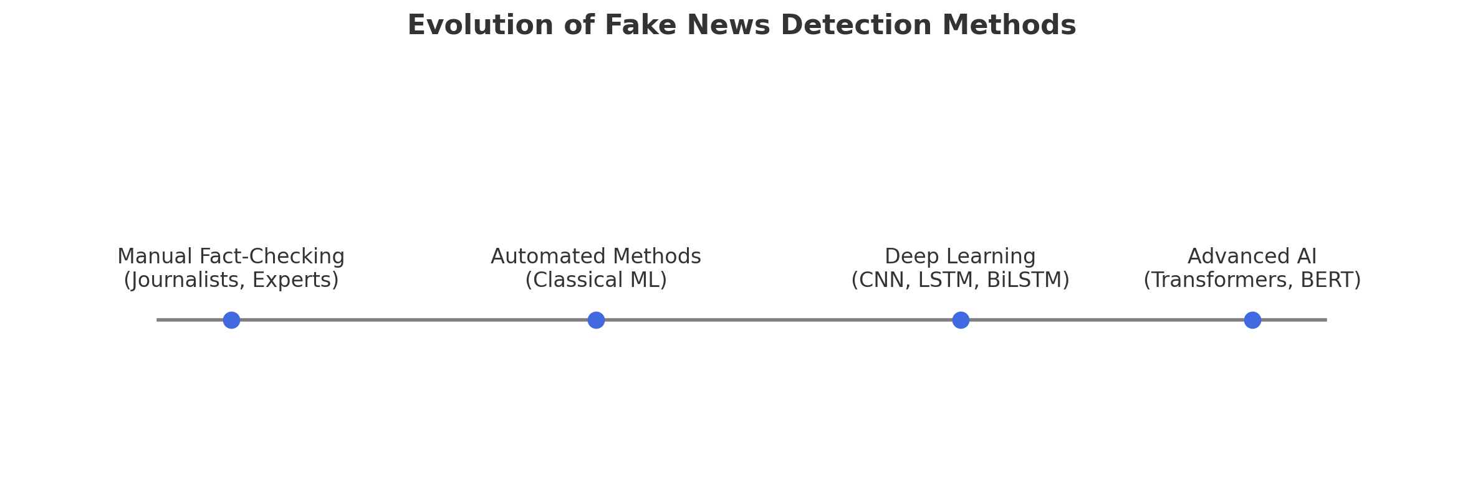
Literature Review: Overview

Slide 6
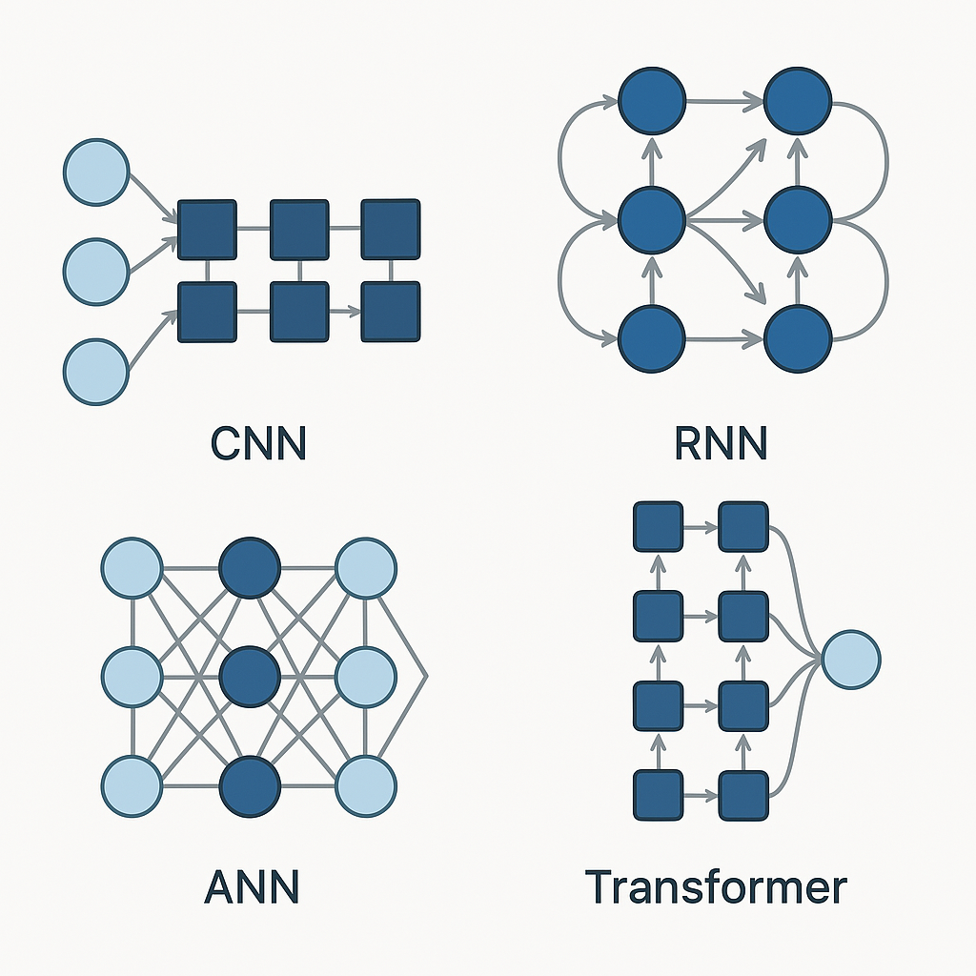
Literature Review - Deep Learning Advances
Convolutional Neural Networks (CNN):
Effective at extracting local linguistic patterns.
Recurrent Neural Networks (RNN):
LSTM and BiLSTM capture context and sequence.
Transformers (BERT, RoBERTa):
Pretrained models with superior understanding of language context.

Slide 7

Literature Review - Gaps & Motivation
Research Gaps:
Need for models balancing accuracy and interpretability.
Real-time deployment challenges.
Project Motivation:
Provide an interpretable deep learning model.
Deliver a practical web application solution.
Bridge the gap between research findings and practical use.

Slide 8
Methodology - Overall Workflow
Data Collection: Acquiring labeled datasets.
Data Preprocessing: Text cleaning, tokenization, padding.
Exploratory Data Analysis (EDA): Insights through visualization.
Feature Engineering: Text-to-sequence conversion.
Model Training & Evaluation: CNN-BiLSTM hybrid architecture.
Deployment: Web-based application for real-time predictions.

Slide 9
Dataset Description
Source: Public datasets (True and Fake news articles)
Total Articles: Approximately 44,898 samples
Labels:
Fake news (23,481 articles)
True news (21,417 articles)
Data Fields:
Title, Text, Date, Subject
Use: Training and evaluating deep learning models

Slide 10
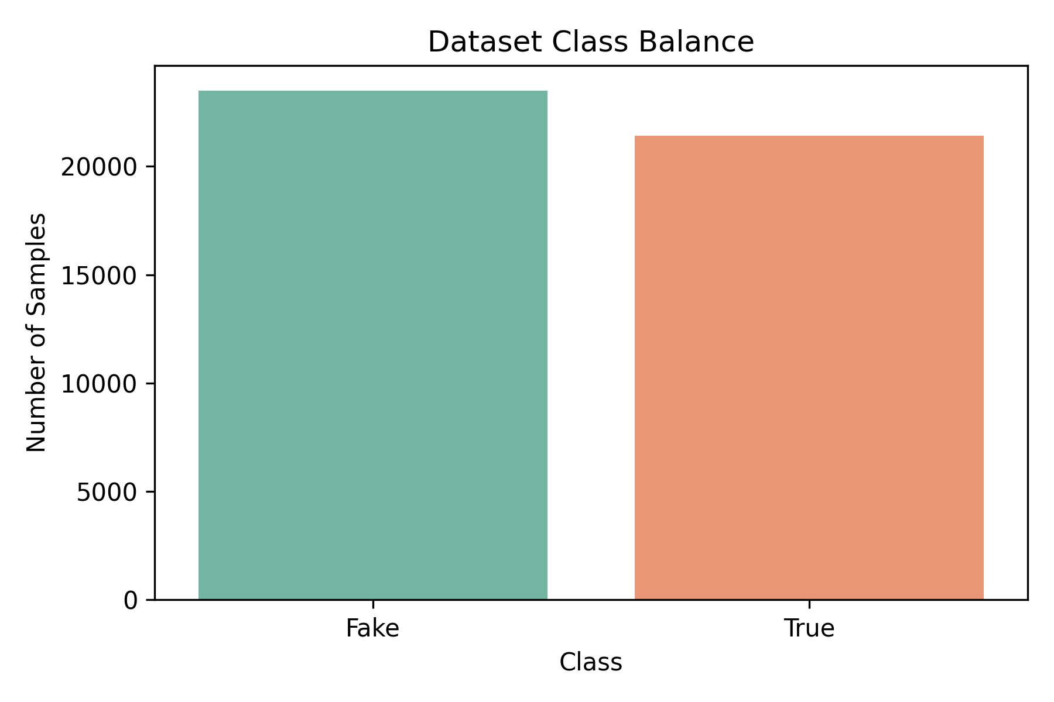
Exploratory Analysis - Class Balance
Class distribution is nearly balanced, allowing effective model training.
Slight imbalance managed via training techniques

Slide 11
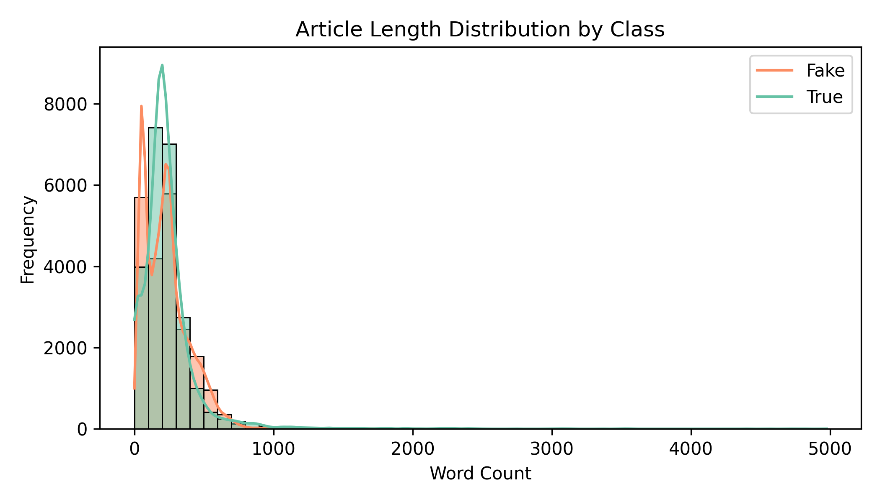
Exploratory Analysis - Article Length Distribution
Visual analysis shows typical lengths of fake vs true news.
Provides insights for text preprocessing and padding strategies.

Slide 12
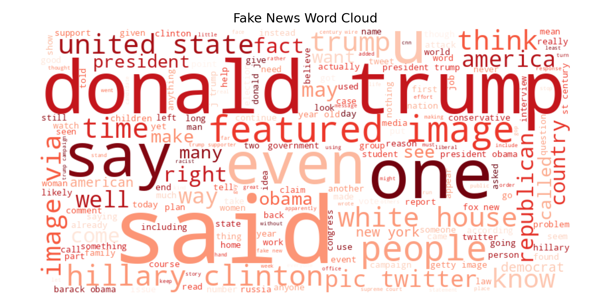
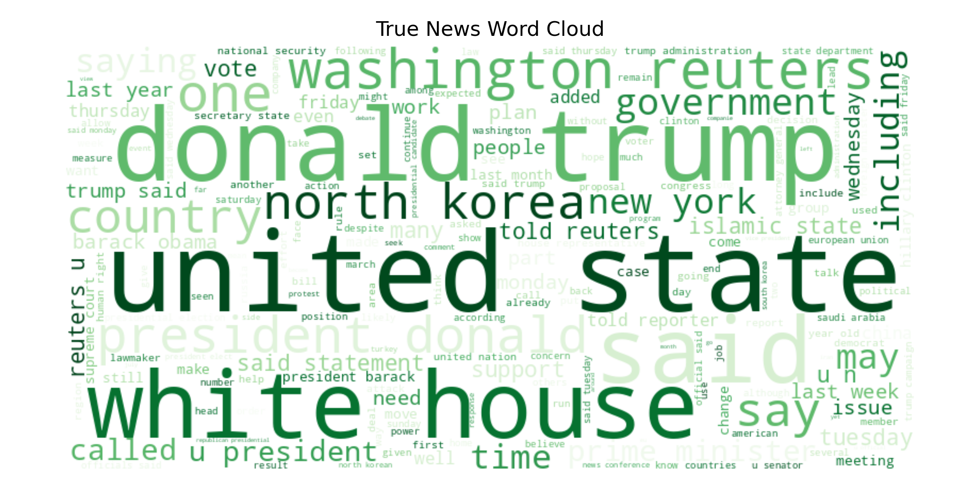
Exploratory Analysis - Word Clouds
Highlights distinct vocabulary differences between fake and true news.
Provides insights into word-level patterns

Slide 13
Data Preprocessing Steps
Text Cleaning: Lowercasing, punctuation removal.
Tokenization: Converting sentences to numerical tokens.
Sequence Padding: Ensuring uniform length across articles.
Vocabulary Creation: Building a fixed-size vocabulary based on frequency.

Slide 14
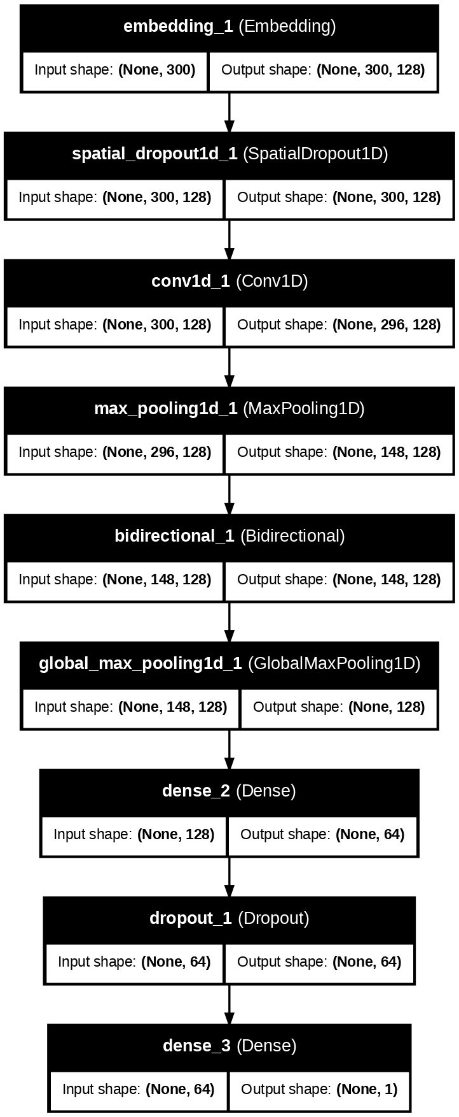
Model Architecture Overview (CNN-BiLSTM)
Hybrid neural network combining:
CNN for local pattern extraction.
BiLSTM for capturing sequence context.
Efficiently captures both local and sequential language patterns.

Slide 15
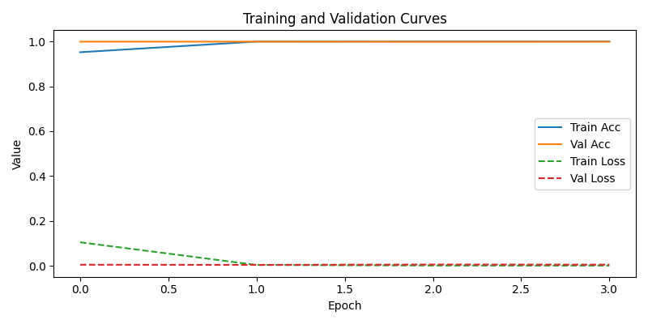
Model Training and Validation
Model trained over multiple epochs.
Accuracy quickly improved, with minimal overfitting.
Validation performance aligned closely with training results.

Slide 16
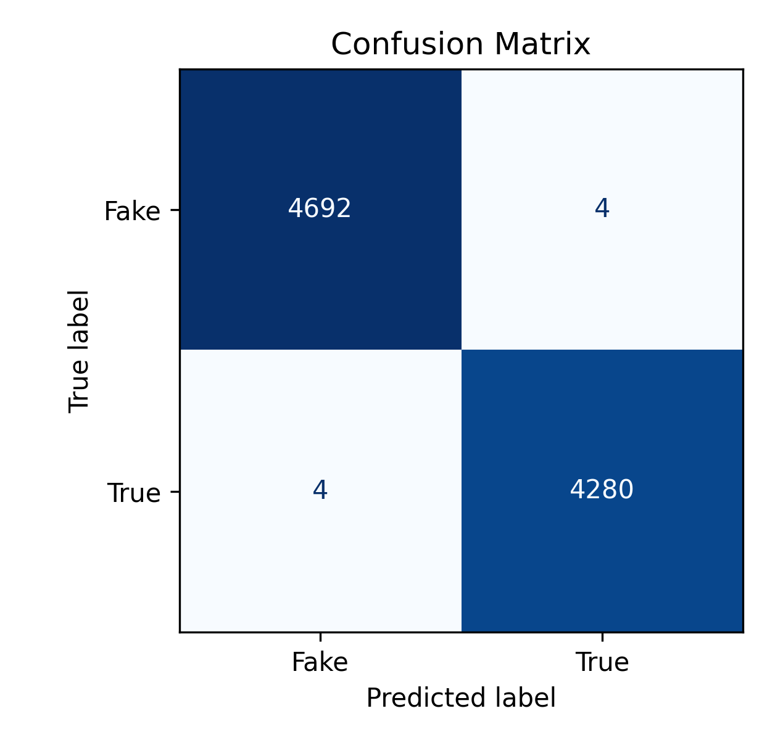
Model Evaluation - Confusion Matrix
Confusion matrix highlights correct and incorrect predictions.
High accuracy demonstrates strong predictive capability.
Few misclassifications indicate robust model performance.

Slide 17
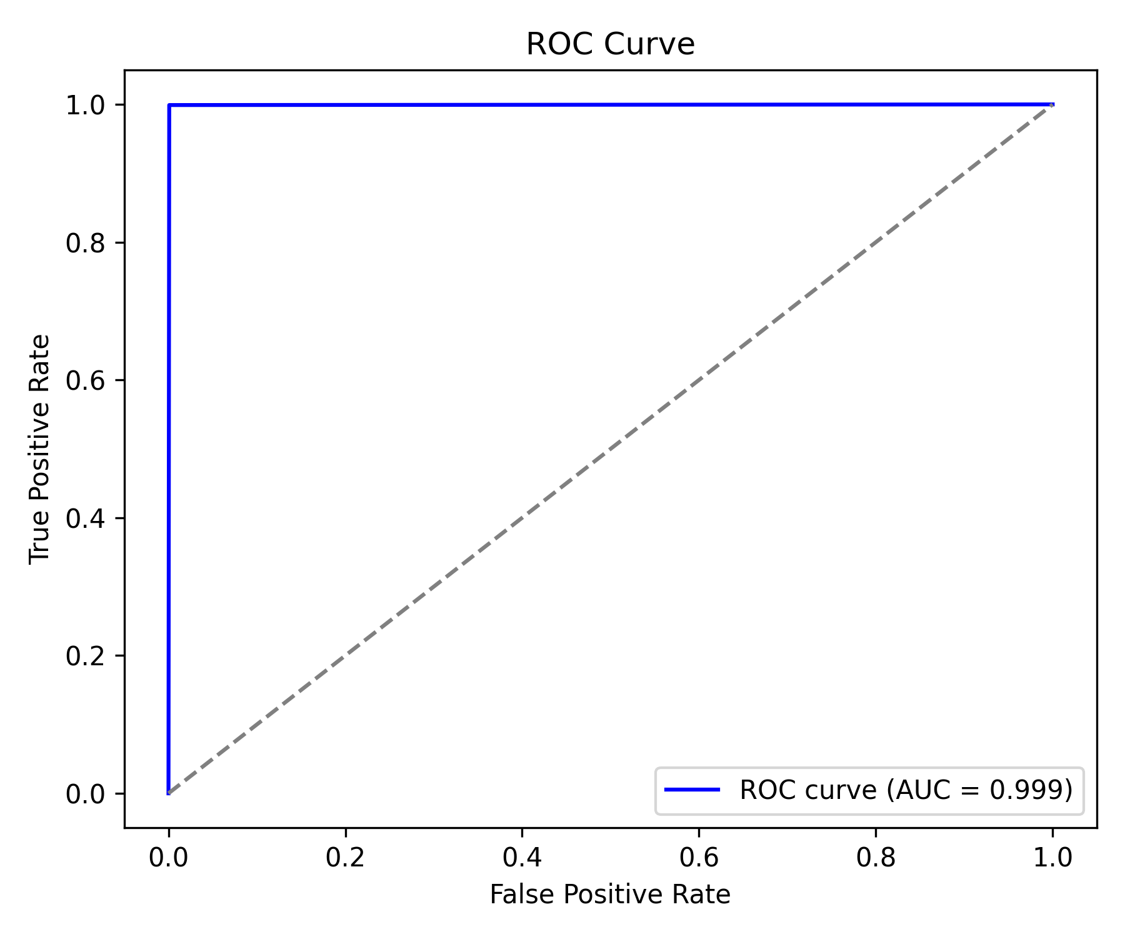
Model Evaluation - ROC Curve
ROC curve shows model's ability to differentiate true vs. fake news.
High AUC indicates excellent performance.
Confirms model’s robustness across various thresholds.

Slide 18
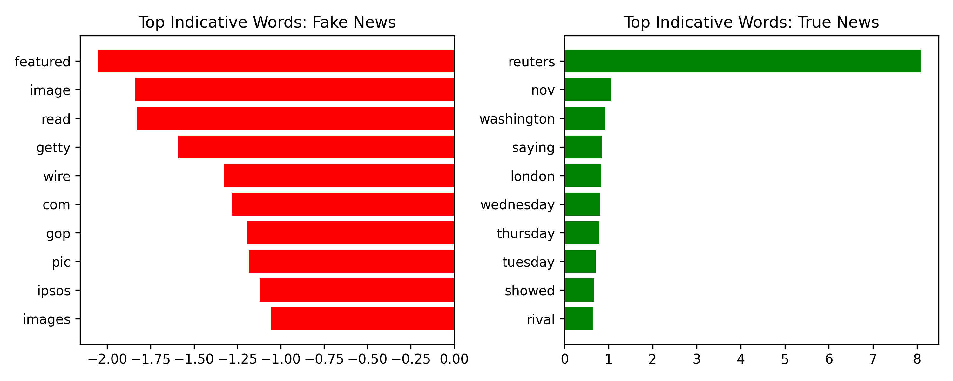
Model Interpretability - Indicative Words
Key words significantly influencing predictions identified.
Clearly distinguishes linguistic patterns in fake vs. true news.
Enhances model transparency for end-users.

Slide 19
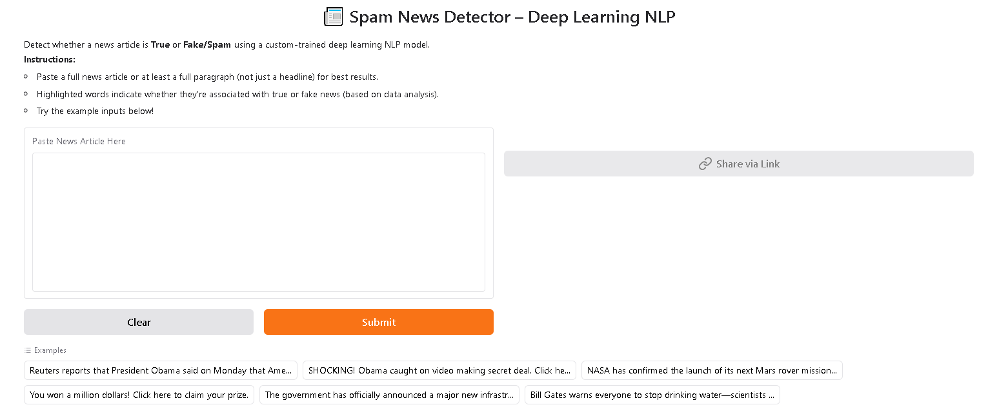
Web Application Demonstration

Slide 20

Conclusion & Future Directions
Successfully developed accurate fake news detection using NLP and CNN-BiLSTM.
Achieved strong interpretability and model transparency.
Practical deployment through accessible web application.
Future Improvements:
Multilingual detection capability.
Continuous learning and adaptation to new misinformation patterns.
Enhanced user interaction and feedback mechanisms.

